Slide 1


WWW Lifecyle
Alexandru Turtu

Slide 2

1. The “caller”
The user opens the browser ( Client)
The user inputs the web address(ex. https://scoalainformala.ro/)

Slide 3

2. The “phone book”
DNS (domain name Server) can be considered the “phone book” of the internet
The client send a request he wants to visit https://scoalainformala.ro/
The DNS serve, will look up the domain and find the IP address

Slide 4
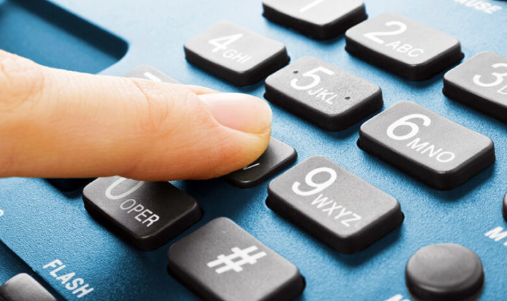
3. The “phone number” and dial
As our browser has the IP address (the “phone number” in the “phone book”) is will send a GET request to the serve

Slide 5
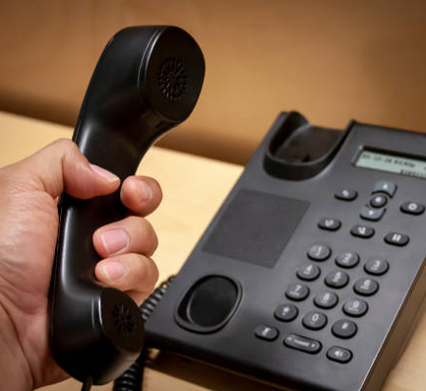
4. The response
The server determines we use the same language (HTML) and the same protocol (HTTP)
Possible responses:
Informational responses ( 100 – 199 )
Successful responses ( 200 – 299 )
Redirection messages ( 300 – 399 )
Client error responses ( 400 – 499 )
Server error responses ( 500 – 599 )

Slide 6
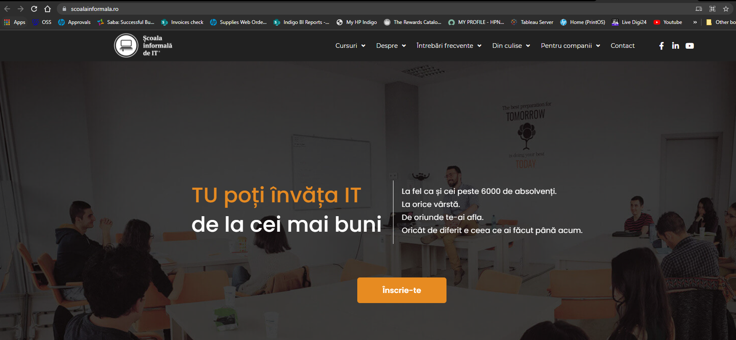
The conclusion
The server sends the response to the client and the web page is displayed

